Slide 1

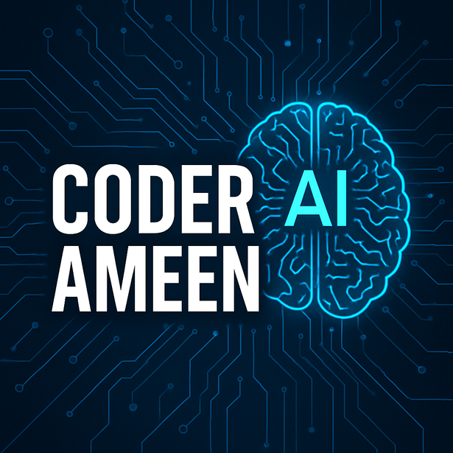

INTRODUCTION TO
GENERATIVE AI
&
LLM
COMPLETE GEN AI AND LLM
YOUTUBE: CODER AMEEN

Slide 2

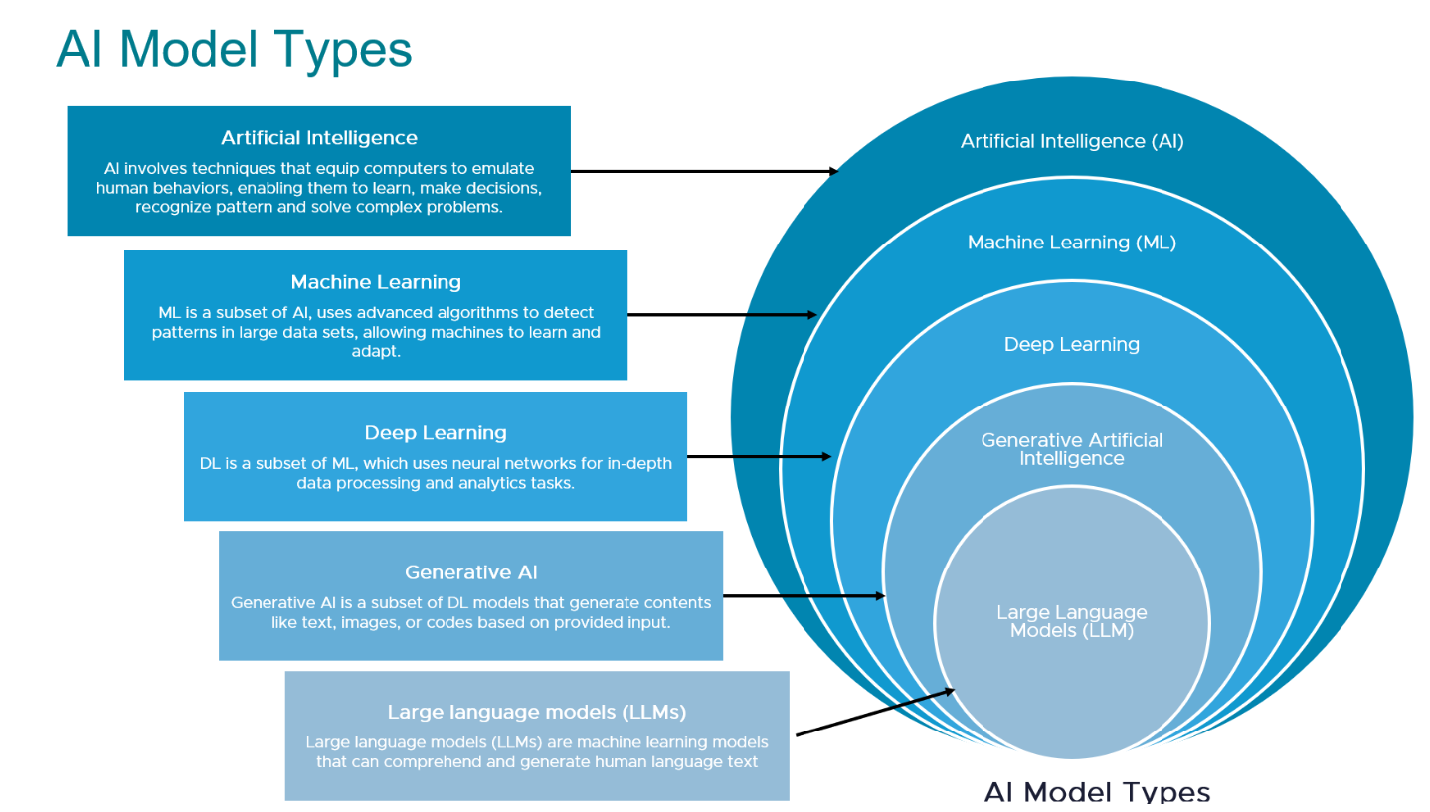

Hierarchy of Artificial Intelligence

Slide 3
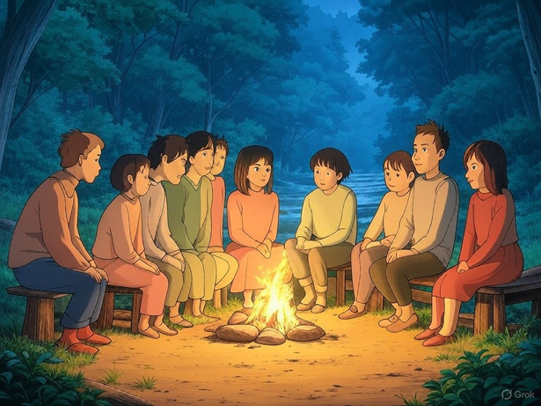
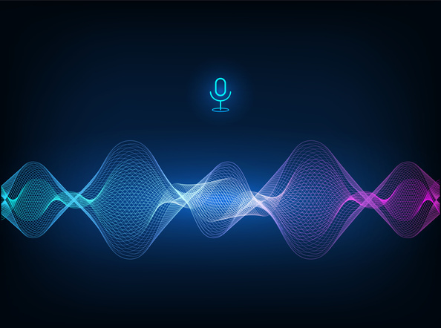
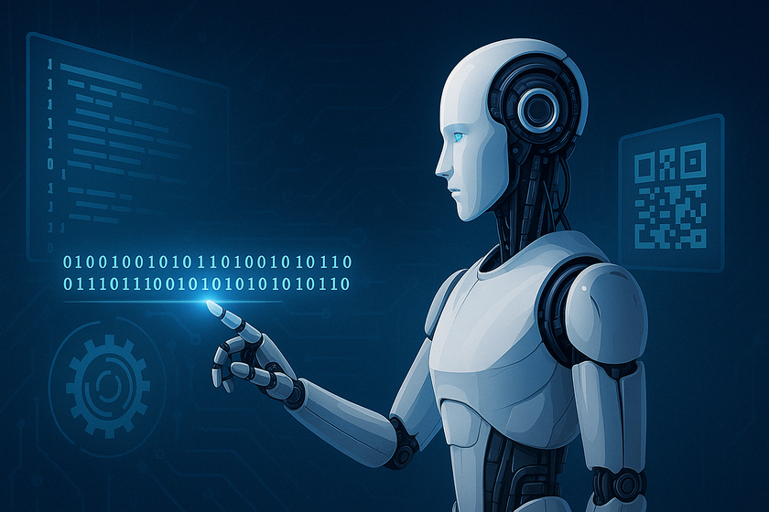
WHAT IS GENERATIVE AI
Genrative AI is also know as Gen AI, it is a type of AI that generate new contents(Images/ text/ voice/ code) using data by replacing human creativity.
Wkt, ML and DL, both doesn’t have capabilites to generate new thing, also it haven’t replace human creativity.
AI image generation
AI Voice generation
AI Code generation

Slide 4
REAL-WORLD APPLICATIONS
📜 Text:
ChatGPT, Copilot, Deepseek (writes emails,stories, answer questions)
🎨 Images:
DALL-E, Midjourney (generate art from text prompts)
🎸 Music:
Jukebox by OpenAI (makes songs in different styles)
🧑‍💻 Code:
GitHub Copilot (helps write code automatically)
📚 Education:
Homework help, lesson syllabus planning
📈 Business:
Report generation, chatbots, email replies

Slide 5
REAL-WORLD APPLICATIONS
🎮 🎭 Entertainment:
Game design, scriptwriting, Cartoons/Anmated videos
💊 Healthcare:
Drug discovery, medical Imaging/X-ray analysis.
🖼️Content Creation and Management:
Generating marketing copy, blog posts and social media content using copy.ai, jasper (formerly Jarvis), Grammarly, Surfer SEO, Frase, Writesonic, Lumen5.
📹 Text to Video:
Lumen5, ElevenLabs
❇Design and visual content:
Canva, Adobe spark, Crello, DeepArt, Designhill

Slide 6
REAL-WORLD APPLICATIONS
💃 Social Media Management:
Hootsuite, Buffer, Later, Lately
📩 Email Marketing:
Mailchimp, Sendinblue, HubSpot, ActiveCampaign
🦸 Personalization and Recommendation:
Dynamic Yield, Optimizely, Algolia, Segment
🤖 Chatbots and customer Support:
Drift, Intercom, Zendesk, LivePerson

Slide 7
BENEFITS OF GENERATIVE AI
⭐Save time and effort
⭐Boosts creativity and productivity
⭐Handles repetitive tasks
⭐Enhances user experience
⭐Exploration and detailing

Slide 8
CHALLENGES AND RISKS
⭕Misinformation (fake news, deepfakes, Mis leading information)
⭕ Privacy concerns
⭕ Job desplacement
⭕ Bias in generated content

Slide 9
THE FUTURE OF GEN AI
💪 Smarter, more human-like interactions.
🌐 Integration into daily tools (browsers, docs etc.)
💡 Democratization of creativity

Slide 10
INDUSTRY AREA WHERE GEN AI USED
Education: Tons of Assignment/test/code generate can easy done.
Entertainment: Characters and enviroment generation for games.
Medical Image Generation: MRI Images, Object X-rays etc.
Text Generation: MCQ Question, document generation, report generation
Apps Development: 2 AI Engineer replaces 10+ developer to build Apps
Content Creation: YouTube clip, Image, blog post, AI Voice services etc.
Customer Support: More than Gen AI for providing end to end customer support chatbot, Agentic AI - using which we can create system that automate every services easily.

Slide 11
WHAT IS LLM
LLM Stands for Large Language Model
LLM is a type of artificial intelligence (AI) that understands and generates human-like text.
Many LLMs are trained on huge sets of data that has been gathered from the Internet thousands or millions of gigabytes worth of text.
LLMs use Machine Learning/Deep Learning technique in order to understand how characters, words and sentences function together by keeping context.
If the information an LLM has ingested is biased, incomplete then the response could be equally unreliable, bizarre or even offensive.

Slide 12
UNDERSTANDING LLM & GENERATIVE AI
LLMs : LLMs only works with Textual data (Human Language)
Generative AI: Gen AI deals with both Textual data and Visual data (IMAGE/VIDEO/AUDIO)
Similarities:
Both are under the AI , ML and DL umbrella.
Both Generate new data.
Both use deep learning.
Both are areas of ongoing research.
Both can utilize transformers.

Slide 13
“AI Won’t replace humans. But humans using AI will relace those who don’t.”

Slide 14
FINAL THOUGHTS
Gen AI is a powerful tool - it’s up to us how we use it.
🚀 Let’s use it responsibly, creatively and wisely.🚀

Slide 15
Implementaion of Generative
AI Using LangChain

Slide 16
WHAT IS GENERATIVE AI
Genrative AI is also know as Gen AI, it is a type of AI that generate new contents(Images/ text/ voice/ code) using data by replacing human creativity.
Wkt, ML and DL, both doesn’t have capabilites to generate new thing, also it haven’t replace human creativity.
AI image generation
AI Voice generation
AI Code generation

Slide 17
TOP TOOLS FOR BUILDING GEN AI APPS/AGENTIC AI
1. LangChain: OpenAi Tool using which we can develop Gen AI Applications. Example: RAG type Applications, Chatbot, Simple Agent
2.Langraph: Highly used to build Gen AI Applications
3.Fast API: Backend framework
4.FrontEnd: HTML, CSS, JSS

Slide 18
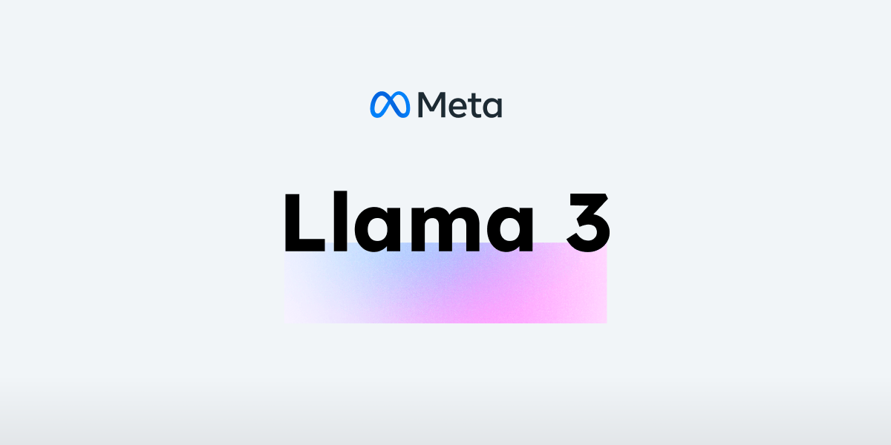

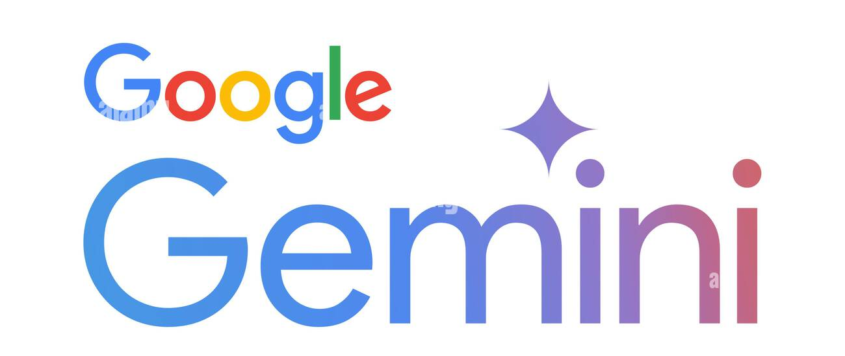
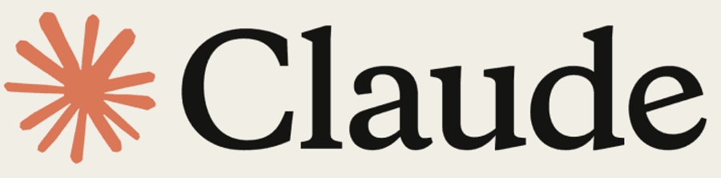
TOP 5 APIs/Models for GenAI Applications
1. OpenAI GPT: (Paid API) load model with help of langchain
2. Anthropic Claude: (Paid API) Microsoft Claude
3. Llama 2(Meta): Facebook Llama usually less used
4. Google Gemini: ((Free API) Open-source

Slide 19
Let’s Implement the Code...

Slide 20
UNDERSTANDING LLM & GENERATIVE AI
LLMs : LLMs only works with Textual data (uses Human Language)
Generative AI: Gen AI deals with both Textual data and Visual data (IMAGE/VIDEO/AUDIO)
Similarities:
Both are under the AI , ML and DL umbrella.
Both Generate new data.
Both use deep learning.
Both are areas of ongoing research.
Both can utilize transformers.

Slide 21
GEN AI IN DETAIL
Generative AI (Gen AI) deals with Textual generation and Visual Generation(Images/videos/Audios)
Examles:
Art and Design: Generate music based on text input prompt, Logo/Thumbnail Generation, System Architecture Designs, Cartoon/Animation videos genertaion etc
Entertainment: Generating videos for Games like PUBG, Animated movies and cartoons.
Medical Image Generation: Medical X-rays and MRI’s
Text Generation: Chat GPT, Copilot, Deepseek

Slide 22
GEN AI IN DETAIL
Two Important branches/techniques/hubs in Generative AI
Stable Diffusion (Diffuser)
HuggingFace (Transformers)

Slide 23
GEN AI IN DETAIL
Stable Diffusion (Diffuser) :
Used to deal with Visual based data generation
Diffuser are the library/framework which provide pre-trained model/classes/function for Visual Data generation(IMAGES/VIDEOS/AUDIOS) we basically use Stable Diffusion.
Stable Diffusion is a type of generative AI model specifically designed for image generation.
Diffusers is a library developed by Hugging Face that provide pre-trained diffusion models, utilities for training and fine tuning and tools for generating high quality imges. It support various diffusion models including Stable Diffusion.

Slide 24
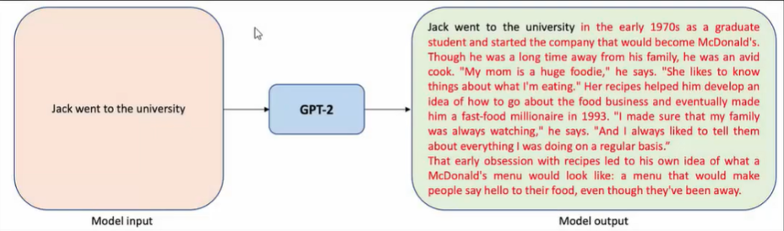
GEN AI IN DETAIL
Hugging Face(Transformers):
It basically deals with Textual based data generation
Hugging Face is a leading provider of open-source machine learning tools, models and datasets with a strong focus on natural language processing (NLP) and deep learning.

Slide 25
UNDERSTANDING LLM & GENERATIVE AI
LLMs : LLMs only works with Textual data (uses Human Language)
Generative AI: Gen AI deals with both Textual data and Visual data (IMAGE/VIDEO/AUDIO)
Similarities:
Both are under the AI , ML and DL umbrella.
Both Generate new data.
Both use deep learning.
Both are areas of ongoing research.
Both can utilize transformers.

Slide 26
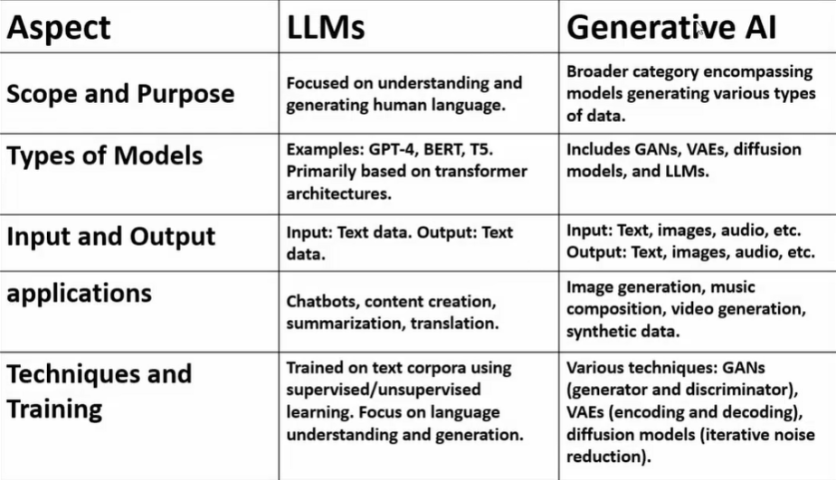
UNDERSTANDING LLM & GENERATIVE AI

Slide 27
Text to Image Generation
Wkt, We have two techniques/Hubs in Gen AI
1. Stable Diffuser (Stability AI): deals with Image
2.Hugging Face (Transformer): deals with Textual data
The stabilityai/stable-diffusion-xl-base-1.0 model is used to generate and modify IMAGES based on text prompts.
* It is a diffusion model that uses two fixed pre-trained text encoders - (OpenCLIP-ViT/G and CLIP-ViT/L)

Slide 28
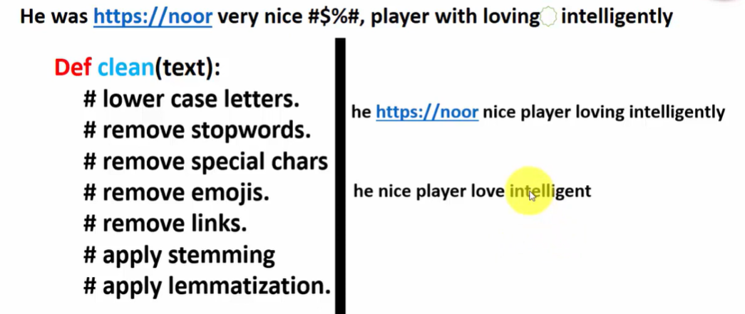
NLP TRANSFORMER PIPELINE

Slide 29
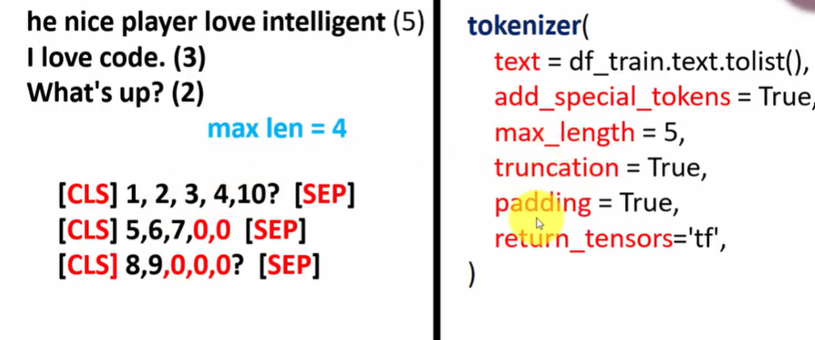
NLP TRANSFORMER PIPELINE
Transformer Tokenizer

